Slide 2

What comes to mind when you hear the word ‘addiction’?

Slide 3
shopping
compulsive stealing
alcohol
opioids
prescription drugs
gambling
eating
playing video games
work
cutting

Slide 4
Exercise
Compulsive lying
Social media
Sugar
Beauty/Plastic surgery
Love
Sex/Porn
Politics
Religion
Phone
Fantasy

Slide 5
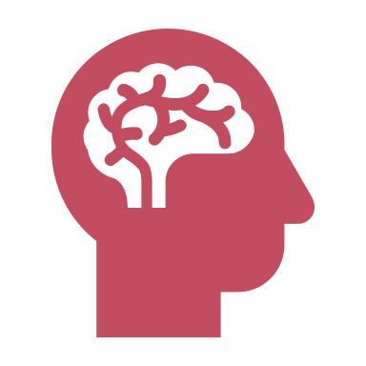
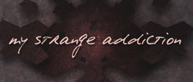

Slide 6
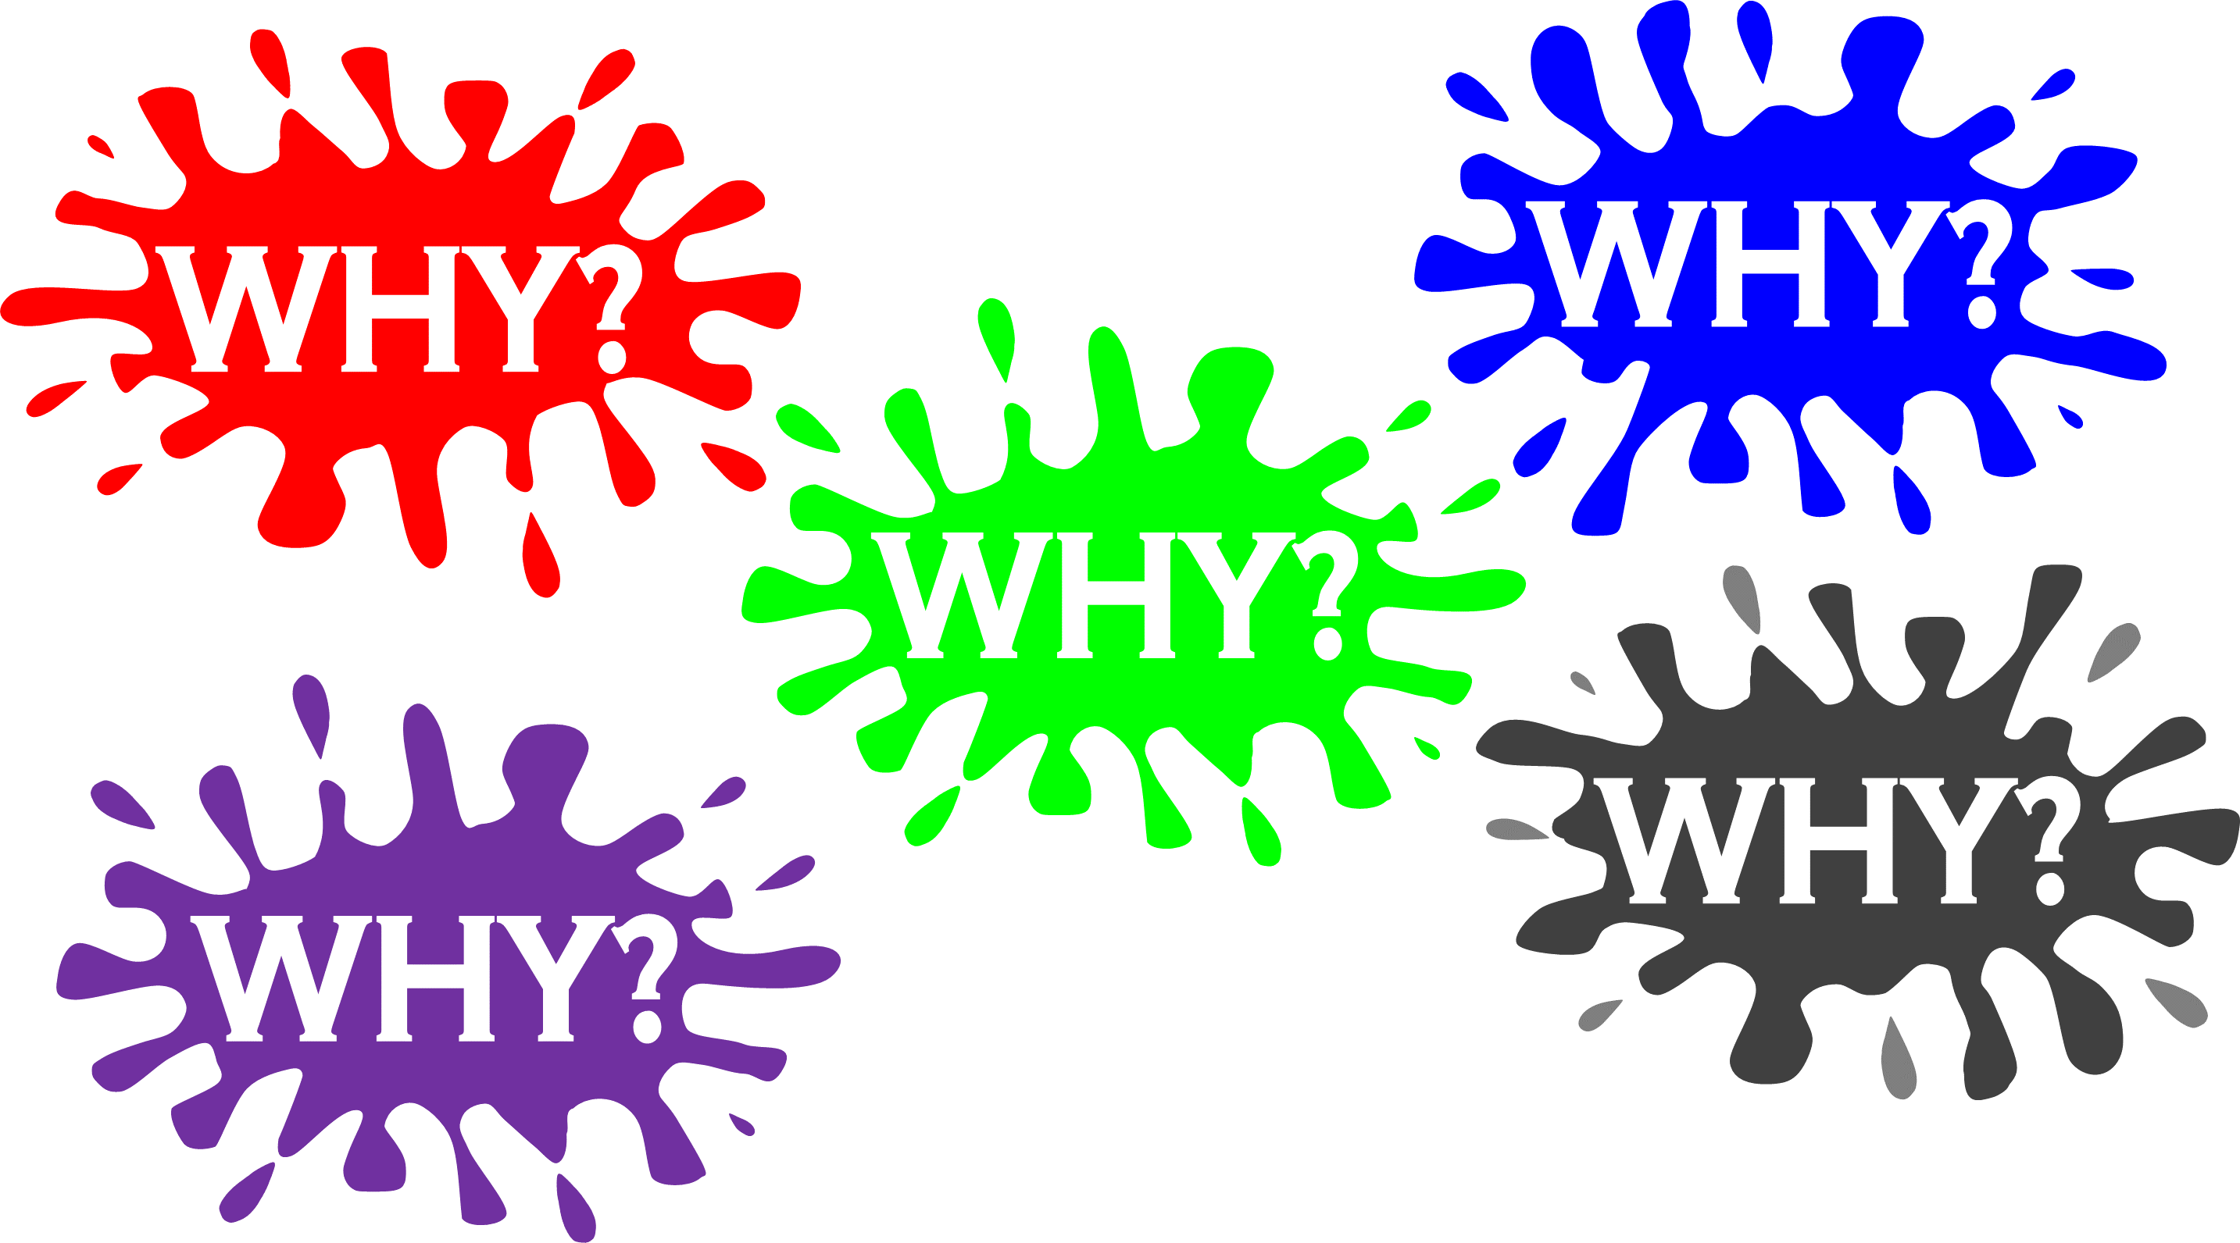
This Photo by Unknown Author is licensed under CC BY-SA

Slide 7
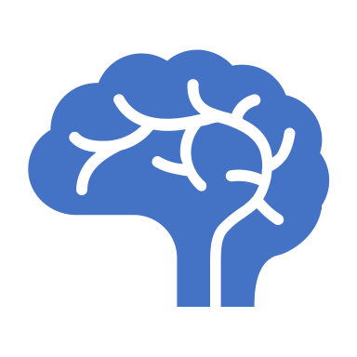
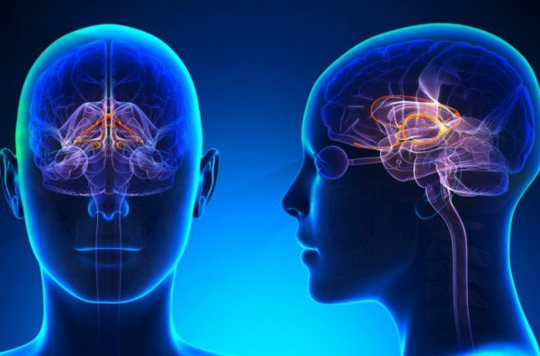
Dopamine
Pleasure
Reward
Memory
Motivation

Slide 8
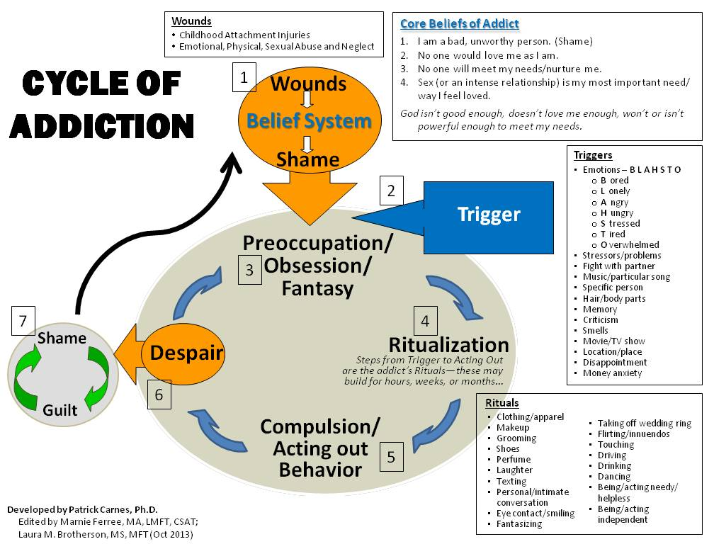

Slide 9
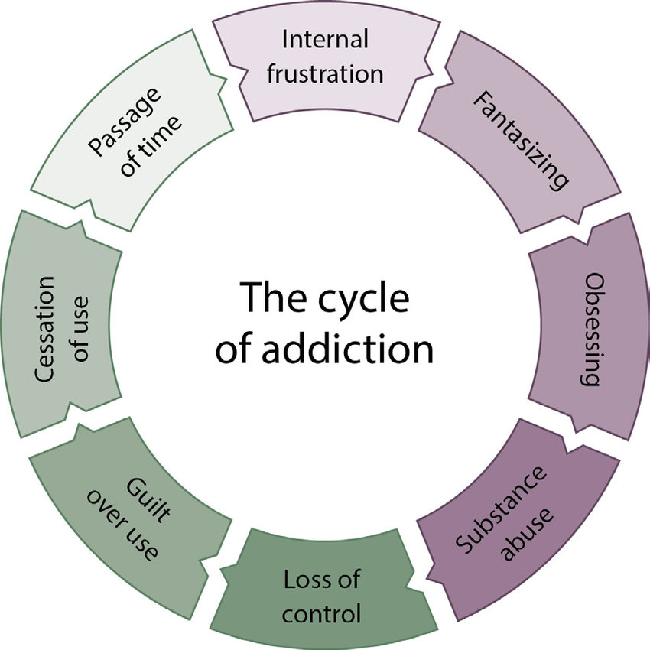

Slide 10
Substance Use
Abuse
Misuse
Dependence

Slide 11

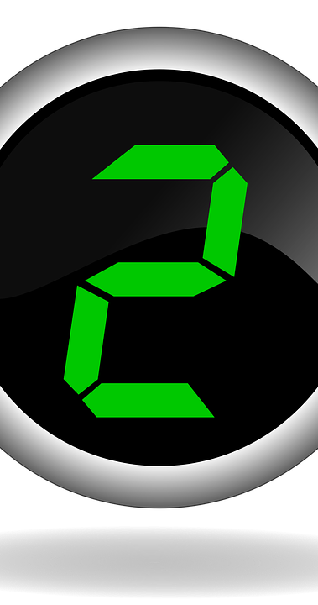
Criteria
Hazardous use
Social or interpersonal problems related to use
Neglected major roles to use
Withdrawal
Tolerance
Used larger amounts/longer
Repeated attempts to control use or quit
Much time spent using
Physical or psychological problems related to use
Activities given up to use
Craving

Slide 12

Causes

Slide 13
Causes
Genes - Family history of addiction. Drug addiction is more common in some families and likely involves genetic predisposition. ...
Mental health disorder. ...
Peer pressure. ...
Lack of family involvement. ...
Developmental stage...
Taking a highly addictive drug
Prescription medication pain
Early use. ...
Stress
Metabolism
Notes:
Mayoclinic.org

Slide 14
Why Is Substance Use Disorder Incapacitating?

Slide 15
Incapacitate
Incapacitate is a verb which means to prevent from functioning in a normal way
It can be disabling, debilitating, immobilizing and paralyzing and can have short term and long-term negative effects
Substance use disorder is a chronic disease involving complex interactions among brain circuits

Slide 16

Effects
Short term
Long term

Slide 17
Short term effects
Drugs are chemical compounds that affect the mind and body depend on the drug, dosage, and delivery method
Intoxication
Raises blood pressure
Changes in appetite
Sleeplessness or insomnia
Increased heart rate
Slurred speech
Changes in cognitive ability
Loss of coordination

Slide 18
Long term effects
Psychological Effects:
  Depression
  Anxiety
  Panic disorders
  Increased aggression
  Paranoia
  Hallucinations
  Affect a person’s memory, learning, and concentration
Physical Health Effects:
  Cardiovascular disease
  Respiratory problems
  Kidney damage
  Liver disease
  Overdose

Slide 19


Slide 20
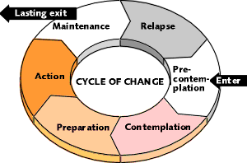

Slide 21
Recovery
Substance use disorder is treatable
Treatment is highly personalized – tailored to a person’s needs
Often requires the support of the individual’s community or family
Treatment often takes a long time and may be complicated
Each substance or behavior may require different management techniques
Some methods include:
  medication-based treatment
  behavioral therapy and counseling
  medical devices to treat withdrawal
  treating related psychological factors, such as depression
  ongoing care to reduce the risk of relapse
Treatment programs by community-based organizations usually involve a combination of behavioral therapy, group therapy, and medication
Notes:
Medicalnewstoday.com

Slide 22
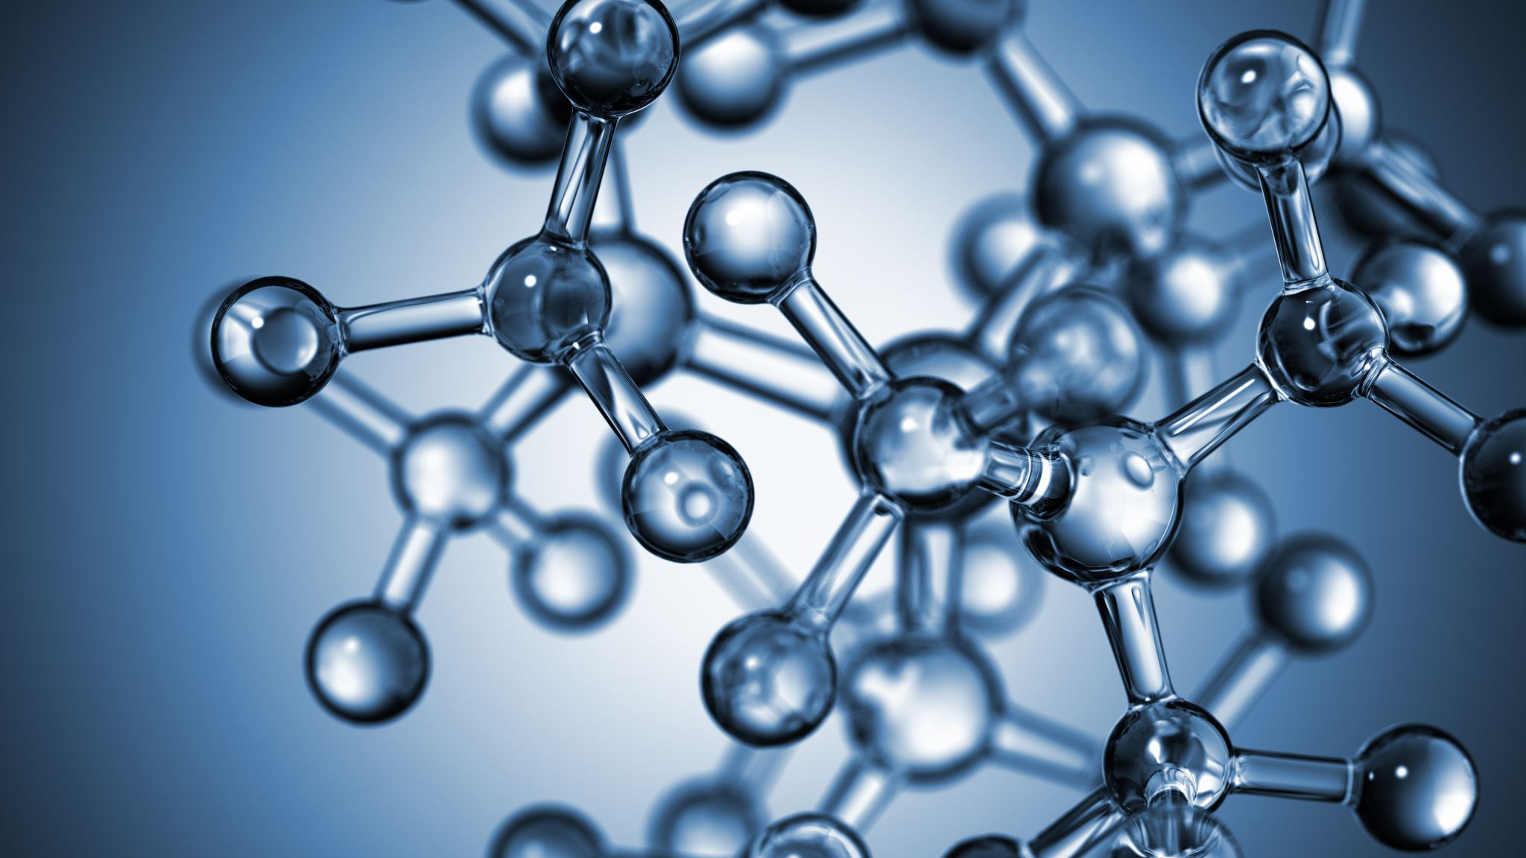
Resources
ConnexOntario – 24/7 Access
1-866-531-2600
ConnexGo App
CAMH – The Centre for Addiction and Mental Health
416 535-8501 or 1 800 463-2338 toll-free, staffed 24/7.

