Slide 1
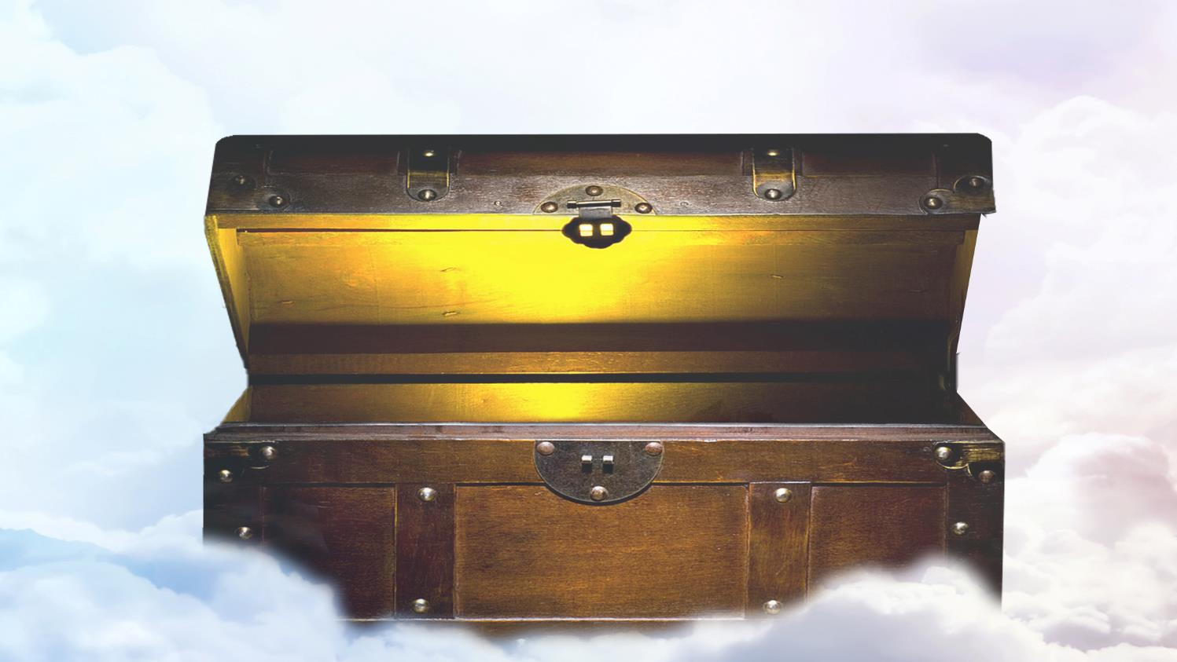
LAYING UP TREASURE IN HEAVEN
Lesson 6 for February 11, 2023

Slide 2
Welcome
Good morning everyone.
Today I just want to walk us through the Lesson study on Laying Up Treasures in Heaven.
Treasure is something of great worth or value to a person.
I am one of co-facilitators/teachers for an online and in-person Sabbath School Class 5.
We usually start with caring and sharing. This I find to be helpful as it sets the tone for the Sabbath School Class. If someone has something on their minds they might find it difficult to communicate, but they have the option to share during the caring and sharing time, they usually recognize that we are interested in them as a person also.
Let’s pray.

Slide 3
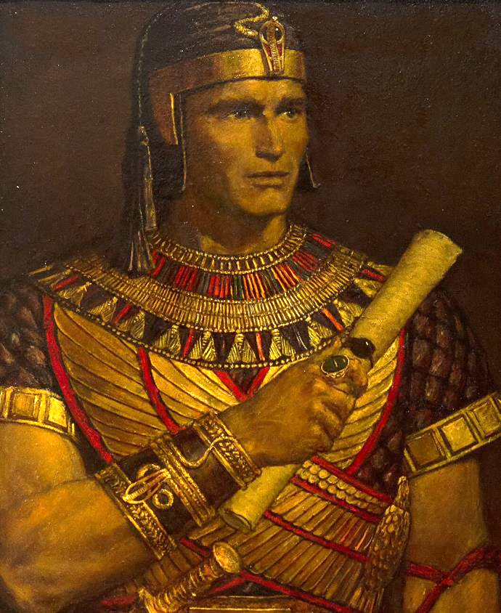
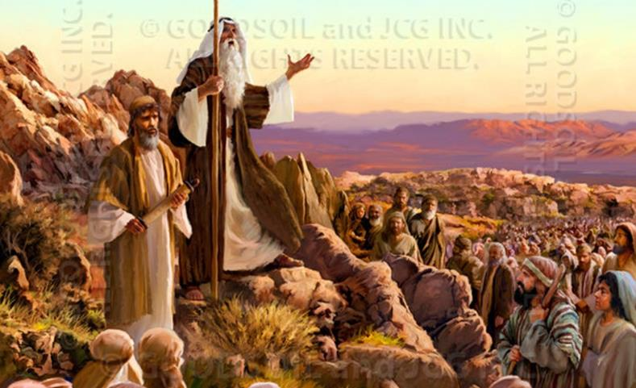
“For what will it profit a man if he gains the whole world, and loses his own soul? Or what will a man give in exchange for his soul?” (Mark 8:36-37)

Slide 4

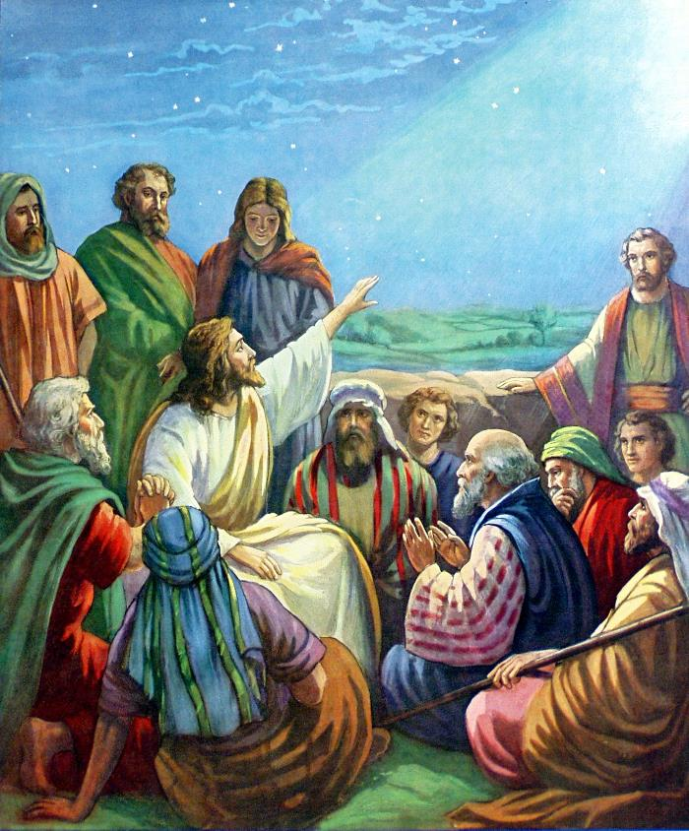







Jesus said: “Do not lay up for yourselves treasures on earth, where moth and rust destroy and where thieves break in and steal; but lay up for yourselves treasures in heaven, where neither moth nor rust destroys and where thieves do not break in and steal.” (Matthew 6:19-20)
How can we lay up treasures in heaven? Let’s learn from those who did so and also from their mistakes.
Laying up treasures in heaven:
Noah, Believing the impossible
Abraham, Obeying by faith
Moses, Rejecting this world
Failing and continuing:
Lot, Leaving this world behind
Jacob, Repenting and moving on

Slide 5

LAYING UP TREASURES
IN HEAVEN

Slide 6

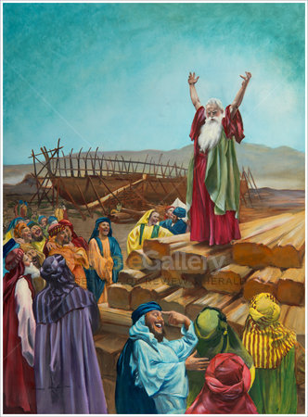
NOAH, BELIEVING THE IMPOSSIBLE
“I am going to bring floodwaters on the earth to destroy all life under the heavens, every creature that has the breath of life in it. Everything on earth will perish.” (Genesis 6:17 NIV)
God decided to eradicate humankind because of their wickedness (Gn. 6:5-8), and He ordered Noah to build an ark (Gn. 6:13-19). Noah’s attitude proved where his treasure was:
Believing the impossible: Rain didn’t exist in that time (Gn. 2:6). The experts claimed that it was impossible for water to come down from the sky.
Obeying God: Noah devoted his life and resources to building the ark and to begging his fellow citizens
to abandon sin.
We face similar challenges today. The experts claim that Creation (the foundation of Sabbath) was impossible. Will we obey God and preach to our fellow citizens?

Slide 7
Noah Found Grace
Questions from Noah Found Grace:
Genesis 6:5–14. What radical changes came into Noah’s life as a result of obeying God? What principles can we find here for ourselves in a world that needs to be warned about impending doom?
How ready would you be to make a major change in your life for God if, like Noah, you were called to do just that? (Hint: See Luke 16:10.)
  10 He who is faithful in what is least is faithful also in much; and he who is unjust in what is least is unjust also in much. Luke 16:10

Slide 8

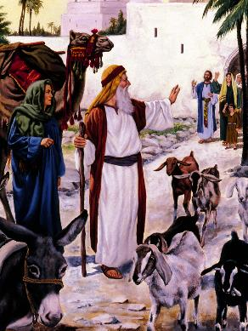
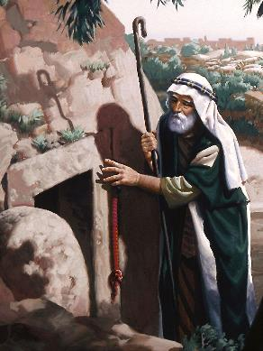
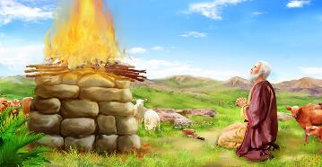
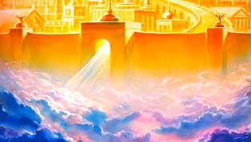
ABRAHAM, OBEYING BY FAITH
“By faith Abraham obeyed when he was called to go out to the place which he would receive as an inheritance. And he went out, not knowing where he was going.” (Hebrews 11:8)
Abraham is considered to be the father of faith (Gal. 3:7). His first act of faith was to leave everything he had behind (his “treasures on earth”) to receive what God was promising (“treasures in heaven”).
He had been promised a land, but he only got a small piece of land in Machpelah (Gn. 23:17-20). However, he never stopped obeying God, waiting for a much better inheritance from Him (Heb. 11:8-10).
The greatest treasure Abraham had on earth was a character similar to Jesus’. That is why his contemporaries considered him a “prince of God” (Gn. 23:6).

Slide 9
Abram, the Father of the Faithful
Questions from Abram, the Father of the Faithful:
Genesis 12:1–3. How were “all the families of the earth . . . blessed” as a result of this promise and its acceptance?
Hebrews 11:8–13. What is the relevant message to us here?
Read 2 Corinthians 4:18. How should the message of this verse impact the kind of spiritual decisions that we make? How did both Moses and Abraham follow that same principle?
  How should the message of this verse impact the kind of spiritual decisions that we make? How did both Moses and Abraham follow that same principle? 2 Corinthians 4:18.

Slide 10

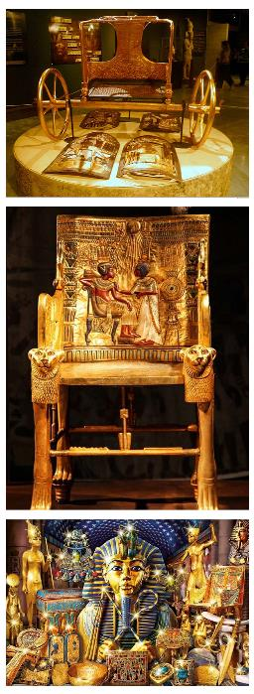
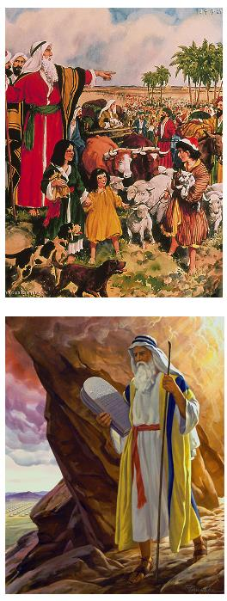
MOSES, REJECTING THIS WORLD
“By faith Moses, when he had grown up, refused to be known as the son of Pharaoh’s daughter. He chose to be mistreated along with the people of God rather than to enjoy the fleeting pleasures of sin.” (Hebrews 11:24-25 NIV)
What did Moses renounce? What did he get in exchange?
Moses was the son of Hatshepsut and the heir of Thutmose II. He could’ve become the next Pharaoh of Egypt.
Egypt was the most important empire on earth in that time. Moses renounced the highest position anyone could have back then.
He rejected all worldly glory and pleasure and chose to fulfill God’s call to free Israel from slavery.
He considered God’s promises “as of greater value than the treasures of Egypt, because he was looking ahead to his reward.” (Hebrews 11:26 NVI)

Slide 11
Moses in Egypt
Questions from Moses in Egypt:
Hebrews 11:24–29. Think about what Moses left behind and what he had to face instead. Try to look at it from his position, before he made the choice. What was he leaving, and what was he choosing to accept by leaving?
From a worldly perspective, Moses should have stayed in Egypt. However, as Christians, we have been given a view of reality that takes us way beyond this world. When we are tempted by the world, how can we keep the big picture always before us? Why is it so important that we do so?

Slide 12
FAILING AND CONTINUING

Slide 13

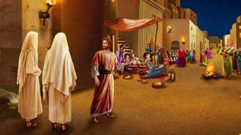
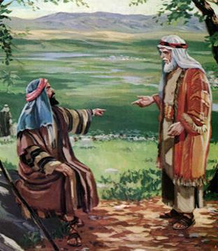
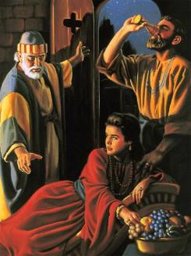
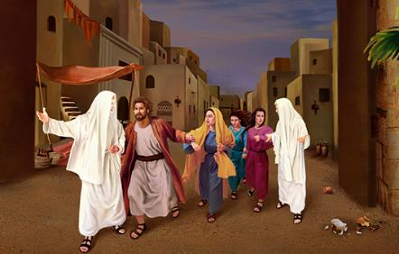
LOT, LEAVING THIS WORLD BEHIND
“[…] Lot dwelt in the cities of the plain and pitched his tent even as far as Sodom.” (Genesis 13:12)
When Abraham suggested Lot that they should take different paths, Lot wanted “treasures on earth” and coveted the plain of the Jordan River. He was gradually pulled by the call of the city (Gn. 13:8-13).
Although he never left God (Peter called him “righteous Lot” in 2 Peter 2:7), his spirituality and his family’s was seriously affected by the life in Sodom.
After Abraham’s intercession, God delivered Lot, his wife, and his daughters from the destruction of Sodom. God told him that he had to renounce this world and flee to the mountains (Gn. 18:22-33; 19:15-17).
Lot doubted but finally left this world behind and decided to live according to God’s instructions
(Gn. 19:30).

Slide 14
Lot’s Bad Decisions
Questions from Lot’s Bad Decision:
Genesis 13:10–12. What rational factors could have led Lot to make the decision that he did?Hebrews 11:8–13. What is the relevant message to us here?
Genesis 18:20–33. What did God tell Abraham was the reason for His visit to earth? What was Abraham’s response to the news that God was planning to destroy these wicked cities?

Slide 15

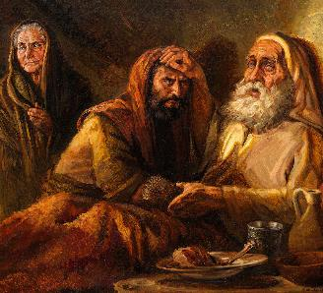
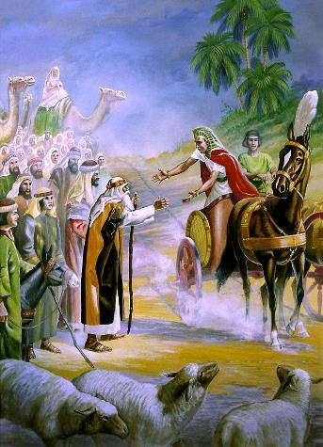
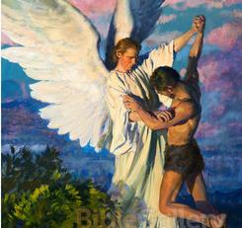
JACOB, REPENTING AND MOVING ON
“And He said, ‘Let Me go, for the day breaks.’ But he said, ‘I will not let You go unless You bless me!’” (Genesis 32:26)
Jacob longed for the blessing his whole life. His mind was set on the “treasures in heaven.” However, he tried to get them on his own terms (Gn. 27:33-35).
After 20 years of work and tricks, Jacob was still suffering the remorse of his foolish action. When he met God, he fought Him to be forgiven and receive the blessing (Gn. 32:22-30).
His life was different after that experience. He no longer trusted himself. Like Abraham and Isaac, his only earthly possession was the cave of Machpelah (Gn. 49:29-31). They understood they were strangers and pilgrims on this earth (Heb. 11:13).

Slide 16
From Deceiver to Prince
Questions from Deceiver to Prince:
Genesis 32:22–31. What happened here to Jacob, and what spiritual lessons can we take from this story about God’s grace, even when we make wrong decisions?
Genesis 49:29–33. Though Jacob no longer had any holdings in Canaan, what instructions did he give his sons regarding his burial? Who else is buried in that cave? Why do you think Jacob made this request?
Despite our mistakes, God can still bless us. How much better, however, to avoid the mistakes to begin with! What choices are you now facing, and how can you avoid making the wrong ones?

Slide 17

“Laying up treasure in heaven will give nobility to the character; it will strengthen benevolence, encourage mercy; cultivate sympathy, brotherly kindness, and charity. It will unite the soul of man with Christ, by links that can never be broken. You may lay up for yourselves treasure in heaven by being rich in good works—rich in imperishable and spiritual things.”
E. G. W. (Our High Calling, July 8)
“No man or woman can lay up treasure in heaven without finding life on earth thereby enriched and ennobled.”
E. G. W. (To Be Like Jesus, June 28)

Slide 18
Discussion Questions:
The slides credit is from:
Presentations made by Sergio Fustero and Eunice Laveda, members of the Seventh-Day Adventist Church in Spain.
You can contact us at: escuelasabatica@fustero.es

