Slide 1
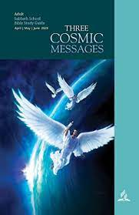
Three Cosmic Messages
Ontario Conference Teacher’s Meeting

Slide 2
PowerPoint® Slides
Use a Sans Serif typeface
Verdana = Sans Serif (28pt)
Times New Roman = Serif (28pt)
A good font to use is Verdana
Always use bold face type
Non bold face
Use 20pt font size or above
20pt font size
24pt font size
28pt font size

Slide 3
Teaching Methodology
Lecture – there are some lessons that require passing on information.
Case Studies – Almost no case studies in this series
Understand/no understand
Use of charts

Slide 4
Why The Lessons Are Important
This series of lessons studies the Three Angel’s Messages of Revelation 14.
Core of Seventh-day Adventist prophetic understanding and teaching.
Core of the Seventh-day Adventist Statement of Mission

Slide 5
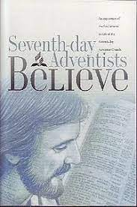
Why The Lessons Are Important
Each of our Fundamental Beliefs is in some way related to the Three Angels’ Messages in Revelation 14

Slide 6
A Core Seventh-day Adventist Doctrinal Topic
It is partly a theological study.
Mostly a personal application approach dealing with how these messages affect our personal spiritual lives.

Slide 7
Core Seventh-day Adventist Application Topics
Personal applications =
What do these message say we SHOULD believe/understand?
What do these lessons say we should NOT believe?
What do these lessons say we SHOULD do and NOT do?
What do these lessons tell us about how we should relate to things like judgment, prophecy timelines, Sabbath keeping, invisible spiritism etc.

Slide 8
Core Seventh-day Adventist Doctrinal Topic
Focus on the three angel’s messages of Revelation 14 is expanded to cover related topics in Revelation 12 through Revelation 17.
There are some issues in the series that will require study and background knowledge on the part of the teacher.

Slide 9
Teacher Alert
All kinds of suppositions and Adventist mythology has grown up around these messages.
It is a Sabbath School teacher’s responsibility to stick to the outlines in these lessons and to recognize and kindly correct erroneous issues that may arise.
Sample - “All non-Adventists are part of Babylon?”
Sample -“If you keep Sunday you already have the Mark of the Beast!”
Sample -“What matters is that God is the Creator, not that He did the job in six days.”

Slide 10
Teacher Alert
The most misunderstood/not understood/wrongly interpreted/most ignored issue we teacher’s face is the “Investigative judgment” = Lessons 5,6

Slide 11
Lesson Organization
Message | Lesson in Series
1 | Lessons 1-4. Outline and analysis of the three messages. Lessons 5,6. The issue of the judgement. “The hour of his judgment has come.” (Revelation 14:7). Lessons 7,8. “Worship him who made . . ..” The role of the Sabbath as worship of the Creator.
2 | Lesson 9 – The fate of mystical Babylon Lesson 10 – The role of spiritualism in the last days

Slide 12
Lesson Organization
Message | Lesson in Series
3 | Lessons 11,12 – The seal of God and the mark of the beast.
Summary | Lesson 13 – An appeal to faithfulness and preparation of the end times.

Slide 13
Lesson List
Lesson | Title
1 | Jesus Wins-Satan Loses
2 | A Moment of Destiny
3 | The Everlasting Gospel
4 | Fear God and Give Glory to Him
5 | Good News of the Judgment
6 | The Hour of his Judgment
7 | Worshiping the Creator
8 | The Sabbath and the End
9 | A City Called Confusion
10 | Satan's Final Deceptions
11 | Seal of God/Mark of Beast -1
12 | Seal of God/Mark of Beast -
13 | Ablaze With God’s Glory

Slide 14
Schedule
Lesson | Title | Teacher
1 | Jesus Wins-Satan Loses | Jim
2 | A Moment of Destiny | Dan
3 | The Everlasting Gospel | Chris
4 | Fear God and Give Glory to Him | Bob
5 | Good News of the Judgment | Doug
6 | The Hour of his Judgment | Jim
7 | Worshiping the Creator | Shepherd
8 | The Sabbath and the End | Dion
9 | A City Called Confusion | Sifa
10 | Satan's Final Deceptions | Andrea
11 | Seal of God/Mark of Beast -1 | Deanie
12 | Seal of God/Mark of Beast - | Chris
13 | Ablaze With God’s Glory | Juan

Slide 15
History Seventh-day Adventist Beginnings
Message 1 - The general duration and effect of Miller’s message. — Great Controversy pp. 11-316; 380.
Message 2 - During the summer of 1844 when many Millerites realized they had to leave, or were disfellowshipped, from their original churches. — Great Controversy pp. 381, 389
Message 3 - The understanding of the Sabbath message by the Millerite group who became Seventh-day Adventists. — Great Controversy pp. 449-460.

Slide 16
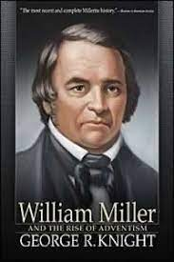
Some Three Angel’s History
The Millerite Revival
The focus was on the 1st Angel’s Message = “The hour of His judgment has come.”

Slide 17
Some Three Angels History
The Millerite Revival
That “hour” became October 22, 1844
The “Seventh-Month Movement”
The “Midnight Cry”

Slide 18
Some Three Angels’ History
After 1844
1844 advocates who later became Seventh-day Adventists
Evangelical Adventists
Assorted “fanatical” groups

Slide 19
Some Three Angels’ History
Before 1844
After 1844
2nd angels’ “Babylon” = Churches who kicked out Millerites
“Fallen” churches
Ex-Millerites who rejected 1844 timeline.
Ex-Millerites who were “fanatics”
Ex-Millerites who rejected the Sabbath

Slide 20
History Seventh-day Adventist Beginnings
Message 1 - The general duration and effect of Miller’s message. — Great Controversy pp. 311-316; 380.
Message 2 - During the summer of 1844 when many Millerites realized they had to leave, or were disfellowshipped, from their original churches. — Great Controversy pp. 381, 389
Message 3 - The understanding of the Sabbath message by the Millerite group who became Seventh-day Adventists. — Great Controversy pp. 449-460.

Slide 21
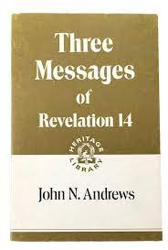
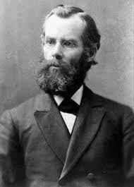
History Seventh-day Adventist Beginnings

Slide 22
Three Angels in Revelation 14
J. N. Andrews –
“It would become us to examine this subject with serious attention.”

Slide 23
Some Hot Button Issues
Theistic evolution. Hot issue among “progressive” Seventh-day Adventists
Misunderstanding (or no understanding) of the judgment and 2300-year prophecy
Misunderstanding (or no understanding) of the judgment and the term “investigative.”

Slide 24
Some Hot Button Issues
Misunderstanding of who is in “Babylon”
Misunderstanding about how you get into or out of ‘Babylon”
Lack of understanding of how the Sabbath is connected to the 3rd Angel’s Message
Misunderstanding (or lack of understanding) about who gets the Mark of the Beast, and when

Slide 25
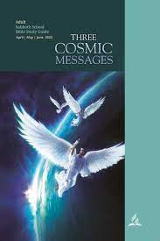
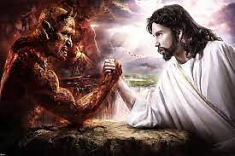
Lesson 1 -
Jesus Wins – Satan Loses

Slide 26
The Book of Revelation
All messages in the Book of Revelation come from the heavenly sanctuary
The Universal Heavenly Control Room from which the Godhead manages the universe.

Slide 27
Revelation 1:1
“The revelation from Jesus Christ,
“which God gave him to show his servants what must soon take place.
“He made it known by sending his angel
“to his servant John, who testifies to everything he saw . . .”
God
Jesus
Angel
Prophet
US

Slide 28
Angels in Revelation
In Revelation some angels stand
In Revelation one angel hands out an edibale book that cause an upset stomach
In Revelation some angels blow trumpets
In Revelation some angels fight
In Revelation some angels distribute plagues
In Revelation 14 angels FLY and urgently deliver three messages

Slide 29
Three Angels in Revelation 14
J. N. Andrews –
“It would become us to examine this subject with serious attention.”

Slide 30
Lesson 1 – Revelation 12
Begins the second half of Revelation - Eschatology
Two beasts go after God’s people
One from the sea
One from the land
A “sign” in heaven = A symbol of a spiritual reality

Slide 31
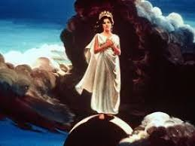
Lesson 1 – Revelation 12
Two “signs”
Sign 1 – a woman
Echo of Song of Solomon 6:10
“Who is this that appears like the dawn,
fair as the moon,
bright as the sun,
majestic as the stars in procession?”
Another echo = 2 Corinthians 4:6

Slide 32
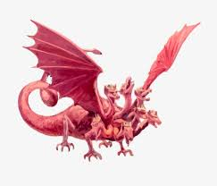
Lesson 1 – Revelation 12
Sign 2 – a “dragon”
“Then another sign appeared in heaven:
“an enormous red dragon with seven heads and ten horns and seven crowns on its heads.
“Its tail swept a third of the stars out of the sky and flung them to the earth. ”

Slide 33
Where Did This “Dragon” Come From?
Revelation 12: 7-9
“There was war in heaven . . .”
Side 1 = “Michael” and his angels.
Side 2 = “The ‘dragon’ and his angels fought back.”
V. 8 – Who won?

Slide 34
Where Did This “Dragon” Come From?
As an early Christian believer, how would you know who this “dragon” is?
Isaiah 14
Ezekiel 28

Slide 35
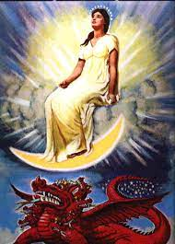
The “Woman”
She shines
She stands on the “moon.”
She’s pregnant and in labor
A “sign” in heaven = A symbol of a spiritual reality
Genesis 3:15 = “And I will put enmity between you and the woman, and between your offspring and hers; he will crush your head, and you will strike his heel.”

Slide 36
The “Child”
Revelation 12:5
“She gave birth to a son, a male child,
who ‘will rule all the nations
with an iron scepter.’”
A blessing to the church
A threat to the Romans
A death sentence to the “dragon.”

Slide 37
The Escape
The Child = Revelation 12:5
The woman = Revelation 12:6
All this is an echo of the exodus experience.
“for 1,260 days”
Time prophecy – 538 A.D. -1798 A.D.
The experience of the “true church” during the Middle Ages in Europe.

Slide 38
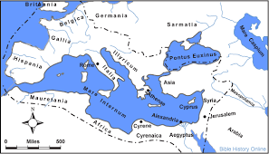
Development of the Christian church

Slide 39
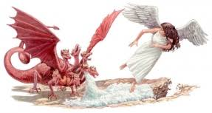
The Escape Experience of the Church
V. 13 – “He (the Dragon) pursued the woman”
V. 14 – How did the church survive?
What’s the time frame of the escape and the survival?
V. 6 = “Where she might be taken care of for 1,260 days.” (538 A. D.-1798 A.D.)

Slide 40
Who Does the Dragon Attack Next?
Revelation 12:17 = “Then the dragon was enraged at the woman
“and went off to wage war against the rest of her offspring—
Offspring identified =
“those who keep God’s commands and hold fast their testimony about Jesus.”

Slide 41
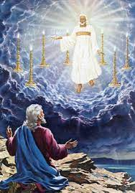
The Praise Song
Revelation 12:10-12

Slide 42
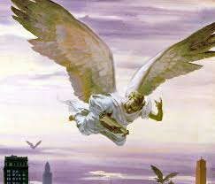
Next Week
Context of Revelation 14
An introduction to the phrase “The hour of his judgment has come”

