Slide 1
Creating Connections, Reaching Urban People Like Jesus
Dr. Julian Jones-campbell
Notes:
Thank Dr. Chichester and his team and you administrators for the invitation.
Urban areas are locations with high population density. Urban areas are in cities and towns.
An urban community is one that's in a city or town: lots of people live there, and there are lots of different kinds of buildings close together.
A suburb is a place where people live just outside of a city or town.
Urban areas are created through urbanization and are categorized by urban morphology as cities, towns, conurbations or suburbs.
What is the difference between urban and city?
? What is the difference between “city” and “urban”? [A city is identified by businesses, a population, and a cul- tural landscape.
Urban locations include non-rural areas like the city and suburbs. ]
synonyms for urban
civic.
civil.
downtown.
metropolitan.
burghal.
central.
citified.
inner-city.
An urban area is often the main area of employment. Urban areas have the most human-built structures.

Slide 2
Matthew 28:18-20
¹⁸ And Jesus came and spake unto them, saying, All power is given unto me in heaven and in earth.
¹⁹ Go ye therefore, and teach all nations, baptizing them in the name of the Father, and of the Son, and of the Holy Ghost:
²⁰ Teaching them to observe all things whatsoever I have commanded you: and, lo, I am with you always, even unto the end of the world. Amen.
Notes:
The mandate to create connections and reaching urban People is embedded in the great commission.
This commission that was given to the disciples is still relevant for us today.

Slide 3
Jesus’ four sending commands
1. I am sending you
2. Make disciples of all Nation
3. Preach repentance and forgiveness
4. “Jerusalem . . . to the Ends of the Earth”
Notes:
In John 20: 21, Jesus explained, “As the Father has sent Me, I also send you” (John 20: 21). Since the Father had sent Jesus “to seek and to save the lost” (Luke 19: 10), Jesus sends us with the same goal of the Father—to seek and to save the lost. For Christ followers this direction can’t be clearer. We are to pick up Jesus’ earthly work and continue doing it. It’s a personal message, and it applies to all of us.”
All groups include urban dwellers
. The first believers heard the Commission, left their homes, and went out to make disciples and plant churches. When we hear the Great Commission, we should also be motivated to go out and plant new congregations. We should follow the example of the early church.”
We need to go where urban dweller are located.
3.
4. The final sending passage from Jesus provides the geography. “You will receive power when the Holy Spirit has come on you, and you will be My witnesses in Jerusalem, in all Judea and Samaria, and to the ends of the earth” (Acts 1: 8).”
Christ will provide the dunamis the power we need to go into urban communities

Slide 4
“Today we think of these geographic locations as concentric circles spreading from “our Jerusalem” or community. Judea may be seen as our state or province and Samaria as our continent (or more accurately, a different culture living in and near our Judea). This is helpful if we want to teach our congregations that missionary work is not all overseas but right here at home, too. For many that’s a radical concept. Yet it’s true, and it’s biblical, based on Acts 1: 8.”
Stetzer, Ed and Im, Daniel. Planting Missional Churches: Your guide to starting churches that multiply. B&H Academic, 2016.
Notes:
Ed Stetzer and Daniel him commented on the great commission by sharing this

Slide 5
Church Planting In The Book Of Acts
Church Planting in Jerusalem (Acts 1–7)
Its Origin
1. Born in prayer (1: 12–14)
2. Bathed in the Spirit (2: 1–4)
3. Begun with proclamation (2: 14–39)”
4. Baptized in the name of Jesus (2: 41)
Notes:
The book of acts gives us our first glimpse of church planting in urban areas so to speak.
Take a look at the outline below through the lens of a church planter created by John Mark Terry. 7”
Reaching the urban community must be born in prayer ,bathed in the spirit the proclamation of the gospel must be done with new methods and then we can baptized then in the name of the LORD!!

Slide 6
Church Planting In The Book Of Acts
A study of Acts reveals that laypersons affected early church planting (8: 1, 4).
They performed mass evangelism (8: 5–6, 12) as well as village evangelism (8: 25).
Through this lay movement churches multiplied (9: 31).
Miracles enhanced the growth of the church (9: 35–42), and salvation reached increasing numbers of Gentiles (10: 44–48).
Later lay Christians from Jerusalem witnessed about Christ and planted a Gentile-Jewish church in Antioch (Acts 11: 20–21).
Notes:
It was lay leaders such as yourselves that’s were engage in church planting in the books of acts and it is you the lay leaders that will reach these urban dwellers for Christ today

Slide 7
Paul The Planter
5. Paul was a flexible, risk-taking pioneer (1 Cor 9: 19–21).
He constantly penetrated new territory (Rom 15: 20).
He focused on finding a new group (Rom 11: 1–14).
He pioneered new methods of ministry (Acts 13).
Notes:
Paul was not afraid to embrace the dense urban areas of his
day.
There are over 8 million People in toronto metropolis alone that needs to be embrace for Christ.
Enoch wile he lived in the mountain he went to the city to minister to the people.

Slide 8
Paul The Planter
Paul cared for people-
He invested personally in the lives of people (Acts 20: 17–21, 31).
He was like a nursing mother and an encouraging father (1 Thess 2: 7–11).
He was vitally concerned with the growth and development of converts (Acts 14: 22).
He drew close to coworkers (2 Tim 1: 2).

Slide 9
E.G. WHITE
When I think of the cities in which so little work has been done, in which there are so many thousands to be warned of the soon coming of the Savior, I feel an intensity of desire to see men and women going forth to the work in the power of the Spirit filled with Christ's love for perishing souls.... Ev 69.3
Notes:
Café ministry
Serve healthy foods
Live christian music
Building connections and relationships to lead people to Christ

Slide 10
E.G. WHITE
My mind is deeply stirred. In every city there is work to be done. Laborers are to go into our large cities and hold camp meetings. In these meetings, the very best talent is to be employed…Ev 69.4
Notes:
Urban camp meeting in Manhattan
-Awareness to the community and to the members of the people to be save in the cities

Slide 11
E.G. WHITE
New methods must be introduced. God's people must awake to the necessities of the time in which they are living. God has men whom He will call into His service,—men who will not carry forward the work in the lifeless way in which it has been carried forward in the past.... Ev 70.1
Notes:
We need New methods in bring the gospel to urban dwellers
PARTHNER with businesses in the community for wakefield
Meet with the community affairs department of the police monthly to hear about the stats of the community and be available when the needs arrive
Meet with the mayor etc. How can we serve these urban dwellers
Barry black making a difference at the highest level but not compromising faith
The 3 Hebrew boys serving in a BABYLON URAN METROPOLIS OF THE DAY
Turn in your guns no question ask at one point when gun violence was wild
Area where gun violence was rampant clergy show up to marches with the local
New methods-creating space for first time offenders
Rehabilitation for those coming out of prison

Slide 12
Contextualization
“The place to begin exegeting the city is contextualization.”
Benesh, Sean. Exegeting the City: What You Need to Know About Church Planting in the City Today. (Metrospiritual Book Series 4).
The dynamic process whereby the constant message of the gospel interacts with specific, relative human situations. It involves an examination of the gospel in the light of the respondent’s worldview and then adapting the message, encoding it in such a way that it can become meaningful to the respondent.”
Notes:
New methods demands contextualization
Exegete –expound/interpret
New methods demands contextualization
We have to reach urban people in there context.
What work as ministry In Markham will not nessicarly work for the homeless in downtown toronto.
We cannot take a replica of what works in Scarborough and bring it to Brampton
We have to bring the message to urban dwellers in their context

Slide 13
Contextual Church Planting
Attempts to communicate the Gospel in word and deed and to establish churches in ways to make sense to people within their local cultural context. It is primarily concerned with presenting Christianity in such a way that it meets peoples’ deepest needs and penetrates their worldviews, thus allowing them to follow Christ and remain in their own cultures.”
Frost, Michael and Hirsch, Alan. The Shaping of Things to Come. Baker Books, 2013.
Notes:
“What we can see from these definitions is that contextualization is the fluid and dynamic process of the Gospel interacting with culture. Each time that takes place it involves a translation on some level whether linguistic, cultural, or worldview.
In one of my district we wanted to reach the people in our community
It was predominantly Hispanic. We faced a linguist barrier.
So a core group in our congregation learned Spanish while we taught English to the community creating partnerships.
We engage our Spanish breather in the process so the community could hear the gospel in their language and remain in their culture.
Bosch reminds us that”
(See next slide)

Slide 14
Contextual Church Planting
“The Christian faith never exists except as ‘translated’ into culture.”
Bosch, David J. Transforming Mission: Paradigm shifts in Theology of mission. Orbis Books, 2011.
Notes:
This idea of “translated into culture” seems obvious when we envision an international setting where the language and culture are foreign to our home culture. This translation or contextualization process must happen even in our cities and the process differs from district to district.”
YOU MAY HAVE TO LEAR SHEEK TO REACH URBAN DWELLERS IN BRAMPTON
Mandarin

Slide 15
Contextual Church Planting
For the sake of mission, contextualization means adjusting how we communicate the gospel so that people do not need to join a new culture in order to hear and understand the message
McCrary, Larry, Tradecraft: For the church on mission. Upstream, 2013
Notes:
To call something “urban” is not a monocultural label that applies to all cities let alone to all parts of the same city”
We don’t have time to address church culture
But
Urban dwellers need seeker friendly environments

Slide 16
In-Migration
“Today the tables have turned in many city centers across the country. There is this in-migration as the appeal for an “authentic” urban life woos many back to the city.”
Benesh, Sean. Exegeting the City: What You Need to Know About Church Planting in the City Today. (Metrospiritual Book Series 4).

Slide 17
Urban Revitalization
To talk about urban revitalization is a large umbrella that encompasses much. It goes beyond creating or recreating the built environment of the city; it encompasses housing, race relations, economics, real estate, community development, justice and equity, architecture, education, politics, and so much more.
Kotkin, Joel, “The Hollow Boom of Brooklyn: Behind the Veneer of Gentrification.” Forbes, 25 Sep. 2012, https://www.forbes.com/sites/joelkotkin
Notes:
The changing city of the 21st-century is more about cultural consumption. “Authenticity” is highly valued. This is one of the arguments made to explain the allure of gentrification.
We have to address housing-
race relations-safe space to
economy –job bank
We have to be authentic when reading to
Father Flagler church in chacigo
On reaching urban dwellers in that city
The church build a housing progect
Job bank
Food bank
All connected to the local congregation

Slide 18
What then are the missiological implications for urban revitalization? As cities change and continue to reinvent themselves, what role should the church play in the process? Do we identify with those on lower income and the marginalized? Do we identify with the growing creative class that cities are recalibrating themselves for?
Benesh, Sean. Exegeting the City: What You Need to Know About Church Planting in the City Today. (Metrospiritual Book Series 4).
Notes:
This is where theology and reality intersex
missiological – the study of religious missions and their methods and purpose
Missiological the study of church mission

Slide 19
Missiological Stating Point
The first realization is that God is and has been at work here in our cities long before we showed up.
Benesh, Sean. Exegeting the City: What You Need to Know About Church Planting in the City Today. (Metrospiritual Book Series 4), p. 157.
Notes:
God goes before us even into the most irreligious situations and creates fields or environments in which our Christlike example can be received. Abraham left ur of the Chaldean confidently because he believes God was with HIM.

Slide 20
Missiological Stating Point
Our job, then, is not to make things happen, but to cooperate with God, who is already making them happen.
Frost, Michael. “Exiles: Living missionally in a post-Christian culture.” 08 Mar. 2006, www.alisonmorgan.co.uk
Notes:
Frost underscores the missiological starting point in reaching urban dwellers
GOD IS WAITING FOR US TO COOPERATE WITH HIM
OUR ECCATOLOGY demands that we engaged with urban dwellers as Christ is soon to come. He desire to save his children and time is running out
Ecatology-theology deals with death, judgment destiny of the soul

Slide 21
A Hermeneutical Principle
An attention to lived experience, especially that of the poor, as the medium in which biblical interpretation takes place.
Notes:
When reaching urban dwellers a hermeneutical principle must be applied
We have to seek to understand their lived experiences so the biblical interpretation can be relevant and accepted

Slide 22
A Cultural Principle
An attempt to make use of indigenous categories in order to convert people to Christ without destroying their memories and cultural identities.
Vanhoozer, Kevin. “One Rule to Rule Them All.” Academia.edu, 1 Jan. 2006.
Notes:
Originating or occurring naturally in a particular place
Indigenous urban categories

Slide 23
Missional Ecclesiology
Most church planters start the church in their head and not in their community. They come with preconceived notions, things they have always wanted to try, and strategies they were never allowed to use. This may make the planter relate better to the church, but the planter is called to reach the community. That requires planting a church into community, a church that is indigenous…
Stetzer, Ed and Im, Daniel. Planting Missional Churches: Your guide to starting churches that multiply. B&H Academic, 2016.
Notes:
The follow-up question then is: How do you ensure an indigenous expression of church? What does that even look like? It goes back to contextualization. Stetzer continues, “But a truly indigenous church seeks to become incarnate within the culture in which it finds itself.” 19 There are some initial questions that we must wrestle with as we figure out what an indigenous adaptation of church looks like. Each question will send us on a journey that forces us into deeper theological reflection. •What is your definition of church? •Was the book of Acts and Epistles prescriptive or descriptive when it comes to church?”
here are more questions to ask when you engage a new host culture with a view to planting a church:”
Who are these people? What is their past? What is their story? How did they get here? What are they like? What are their hopes, their dreams, their future goals? •How do you become an insider? •What is their view of God and/ or spiritual things? •Where do you see God already at work? •How would you go about engaging them with the Gospel? How will you teach them about God? •What do you do if people respond to the Gospel and begin the journey of following God? •How much of a non-contextualized Christianity will you import from your own host culture? How do you ensure that the new church is biblically faithful as well as a contextualized expression? •What other questions should do you ask? Contextualization is a tough and messy job! T

Slide 24
Demographics
Demographic data refers to data that is statistically socio-economic in nature such as:
Population
Race
Income
Education
Employment
Demographics represent specific geographic locations and are often associated with time.

Slide 25
Demographic Data
Statistics Canada:
See the latest Census Profiles 2021: Search by place name or search a postal code to see demographic tables for corresponding geographic levels from province/territory to small dissemination areas.
Search using the StatsCan GeoSearch tool.
Use the map to zoom in to a location or search a location name/postal code using the search bar
Scroll below the map to view data and analysis on the area specified in the map including census profiles
Notes:
Is Toronto Urban or Suburban?
Toronto is, according to the Stats Canada classification, 88.5% suburban, with 11.5% in the urban core (Downtown and Inner Fringe). The largest population is in the Distant Suburbs (30 minutes and more from Downtown), at 37.5%, with the Intermediate Suburbs housing 29.3% (Figure 3, below).Feb 15, 2022
Canada's largest metropolitan area is Toronto, in Ontario. In 2022. Over 6.6 million people were living in the Toronto metropolitan area. Montréal, in Quebec, followed with about 4.4 million inhabitants, while Vancouver, in Britsh Columbia, counted 2.8 million people as of 2022.Jan 19, 2023
Toronto is the only major urban area in the New World (Australia, Canada, New Zealand and the United States) that is more dense than Los
Angeles ...
Why is Toronto so suburban?
It was now economically viable for developers to build on a much grander scale, creating entire subdivisions rather than just a few homes for resale.

Slide 26
Demographic Data
Ontario Ministry of Finance Demographics: Includes a section on population projections, access to the Ontario Demographic Quarterly publication, and census highlights.
MarketLine City Statistics: Select one of the tabs at the top of the dashboard (e.g. demography). Set the Geographic filter to North America, Canada, and select cities in Ontario including Sudbury, Guelph, Hamilton, Kingston, Kitchener-Cambridge-Waterloo, London, Oshawa, Ottawa-Gatineau, Peterborough, St. Catherines-Niagara, Sudbury, Thunder Bay, Toronto, and Windsor.
Conference Board of Canada: Search for a city in Ontario and look for "Metropolitan Outlook" or "Major City Insights" reports.

Slide 27
Demographic Data
Statistic Canada
CANSIM via CHASS
Canada at a Glance
Population and Demography
Census of Canada (2016)
Census of Canada (2011)
National Household Survey (2011)
Province/Territory and City Resources:
London Neighbourhood Profiles 1996-2016
Ottawa Neighbourhood Profiles A-Z
City of Toronto Neighbourhoods & Communities
Ontario.ca

Slide 28
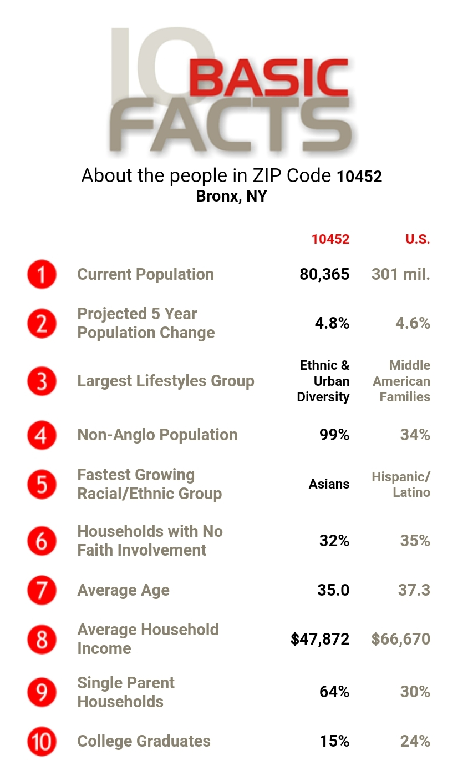

Slide 29
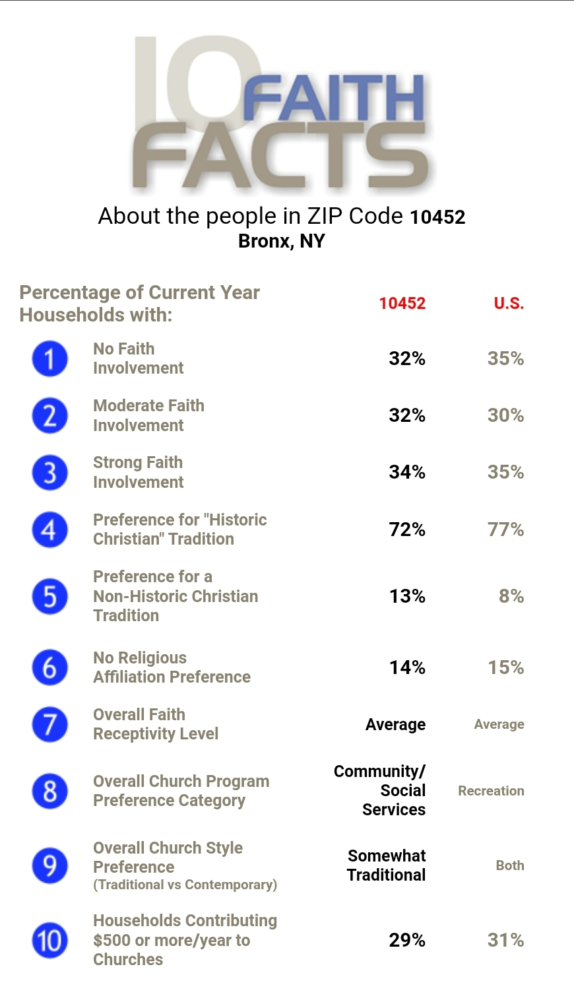

Slide 30
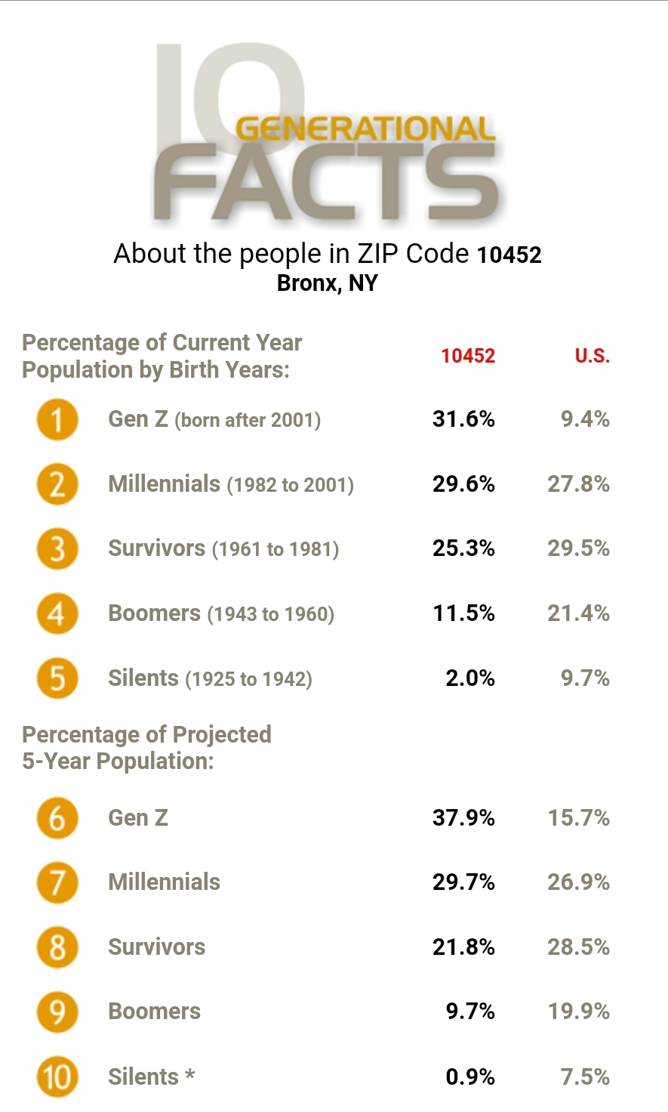

Slide 31
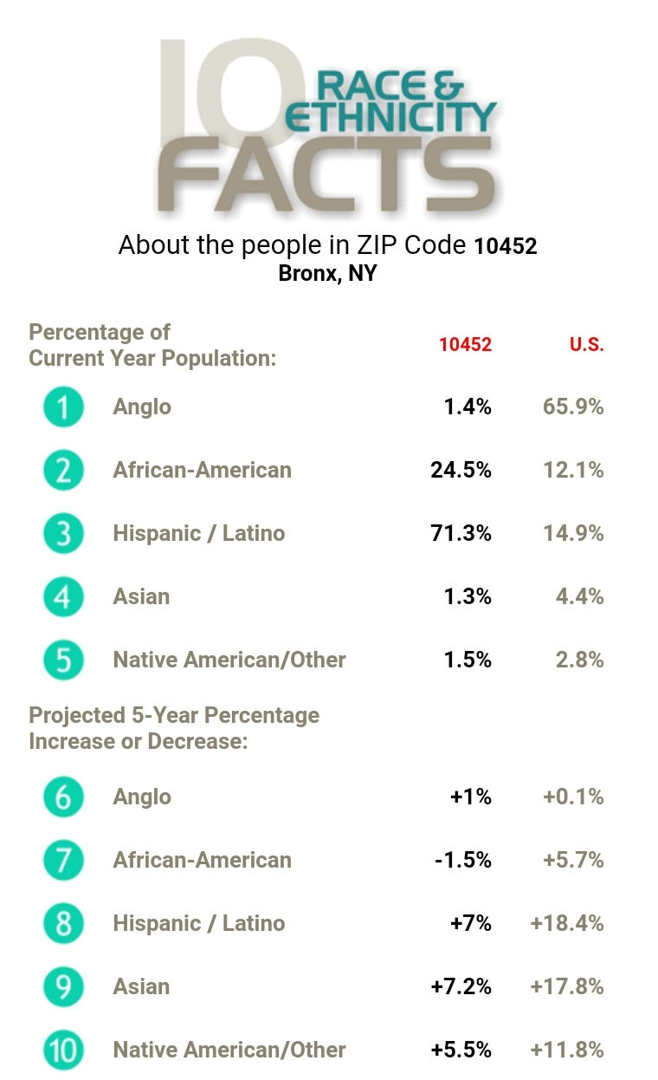

Slide 32
References
Benesh, Sean. Exegeting the City: What You Need to Know About Church Planting in the City Today. (Metrospiritual Book Series 4).
Bosch, David J. Transforming Mission: Paradigm shifts in Theology of mission. Orbis Books, 2011.
Coleman, Robert E. The Master Plan of Evangelism. Revell, 2010.
Conn, Harvie M. Planting and Growing Urban Churches: From Dream to Reality. Baker Academic, 2012.
Frost, Michael. “Exiles: Living missionally in a post-Christian culture.” 08 Mar. 2006, www.alisonmorgan.co.uk
Frost, Michael and Hirsch, Alan. The Shaping of Things to Come. Baker Books, 2013.
Hull, Bill. The Complete Book of Discipleship: On Being and Making Followers of Christ. Nav Press, 2006.
Iorg, Jeff. The Case for Antioch: A Biblical Model for a Transformational Church. B&H Publishing Group, 2011.
Kotkin, Joel. “The Hollow Boom of Brooklyn: Behind the Veneer of Gentrification.” Forbes, 25 Sep. 2012, https://www.forbes.com/sites/joelkotkin
Lingenfelter, Sherwood. Leading Cross-Culturally: Covenant Relationships for Effective Christian Leadership. Baker Academic, 2008.
Notes:
The book of acts gives us our first glimpse of church planting in urban areas so to speak.
Take a look at the outline below through the lens of a church planter created by John Mark Terry. 7”
Reaching the urban community must be born in prayer ,bathed in the spirit the proclamation of the gospel must be done with new methods and then we can baptized then in the name of the LORD!!

Slide 33
References
McCrary, Larry, Tradecraft: For the church on mission. Upstream, 2013.
Malphurs, Aubrey, Advanced Strategic Planning: A 21st Century Model for Church and Ministry Leaders. Baker Books, 2013.
Ogden, Greg. Transforming Discipleship: Making Disciples a Few at a Time. InterVarsity Press, 2003.
Peterson, Brooks. Cultural Intelligence: A guide to working with people from other cultures. Intercultural Press, 2004.
Putman, Jim, Harrington, Bobby, and Coleman, Robert. DiscipleShift: Five Steps That Helps Your Church Make Disciples Who Make Disciples. Zondervan, 2013.
Searcy, Nelson, Thomas, Kerrick, and Dykes Henson, Jennifer. Launch: Starting a New Church from Scratch. Baker Books, 2017.
Stetzer, Ed. Planting Missional Churches. B&H Publishers, 2006.
Stetzer, Ed and Bird, Warren. Viral Churches: Helping Church Planters Become Movement Makers. Jossey-Bass, 2010.
Stetzer, Ed and Im, Daniel. Planting Missional Churches: Your guide to starting churches that multiply. B&H Academic, 2016.
Vanhoozer, Kevin. “One Rule to Rule Them All.” Academia.edu, 1 Jan. 2006.
Notes:
The book of acts gives us our first glimpse of church planting in urban areas so to speak.
Take a look at the outline below through the lens of a church planter created by John Mark Terry. 7”
Reaching the urban community must be born in prayer ,bathed in the spirit the proclamation of the gospel must be done with new methods and then we can baptized then in the name of the LORD!!

Slide 34
Other Sources
Counter Culture: Following Christ in an Anti-Christian Age by David Platt.
The Nuts and Bolts of Church Planting: A Guide for Starting Any Kind of Church by Aubrey Malphurs.
The Honest Guide to Church Planting: What No One Ever Tells You about Planting and Leading a New Church by Tom Bennardo.
Church Plantology: The Art and Science of Planting Churches (Exponential Series) by Peyton Jones.
For the City: Proclaiming and Living Out the Gospel by Darrin and Matt Carter.
Church-Planting Revolution: A Guidebook for Explorers, Planters and Their Teams by Winfield Bevins.
Notes:
The book of acts gives us our first glimpse of church planting in urban areas so to speak.
Take a look at the outline below through the lens of a church planter created by John Mark Terry. 7”
Reaching the urban community must be born in prayer ,bathed in the spirit the proclamation of the gospel must be done with new methods and then we can baptized then in the name of the LORD!!

